Slide 1
Legal & Regulatory Briefing to SAVCA members 22 July 2014 8:00am to 9:30am

Slide 2
Agenda
Welcome Erika van der Merwe
Taxation and SARS Reporting:
FATCA Craig Dreyer
Section 23N of Income Tax Act Craig Dreyer
IT3 Craig Dreyer
Dividend-Withholding Tax Craig Dreyer, Richard Flett
Interest-Withholding Tax Craig Dreyer, Richard Flett
Licencing and marketing matters:
FSB Licence Category for Private Equity Richard Flett
AIFMD J-P Fourie
BEE:
Generic DTI BEE codes and the FSC Codes Danny Hatfield

Slide 3
FATCA

Slide 4
FATCA – Foreign Account Tax Compliance Act
Legislation emanating out of US
SARS (South Africa) has signed and Inter-Governmental Agreement (IGA) with the US
Now FATCA is part of SA Income Tax Act (under Tax Administration)
PE Fund Managers are deemed to be caught in FATCA net
SA Fund Managers required to register on US portal prior to December 2014
SARS required first reporting to take place for period 1 July 2014 to 28 February 2015 by June 2015
Transactions to be reported are ones with US LPs/investors
If no US investors are still required to report certain header fields
Reporting to be done on magnetic tape in layout prescribed by SARS
SAVCA has identified service providers who can assist

Slide 5
Section 23N of Income Tax Act

Slide 6
Section 23N of Income Tax Act
Limitation on deduction of interest where:
Interest incurred by acquiring company
Debt used for re-organisation of transaction
Re-organisation is:
Section 45 inter-group transaction
Section 47 liquidation transaction
Purchase of shares in operating company
When debt is re-financed
Repo rate adjustment when repo rate exceeds 10%, prior to 10% use B = 40%
A = B x ^{C}/_{D}
A is % to apply
B is 40 (40% interest deduction deemed reasonable)
C is average repo rate
D is 10

Slide 7
Section 23N of Income Tax Act
Example if Repo rate is 11
A = B x ^{C}/_{D}
A is % to apply
B is 40 (40% interest deduction deemed reasonable)
C is average repo rate
D is 10
A = 40 x ¹¹/₁₀
Percentage to apply = 44%

Slide 8
Section 23N of Income Tax Act
Engagement with National Treasury (NT)
SAVCA has had 3 meetings with NT (last 2 in January and May 2014)
Requested indexing formula be amended, too punitive with indexing kicking in at 10% repo-rate
Asked for interest disallowed to be carried forward
Meeting with NT was positive – now waiting for Tax Amendment Bill to see if proposal accepted

Slide 9
IT3 Reporting

Slide 10
IT3 Reporting
Government Gazette notice issued 5 April 2013 (No. 260)
Includes Financial Institutions regulated by FSB
Requires IT3 reporting in data file (SARS specifications)
Two reporting periods
1 March to 31 August (by 31 October)
1 September to 28 February (by 31 May)
If less than 20 records manual reporting permitted
SAVCA obtained legal opinions
Opinions conflict
SAVCA trying to engage with SARS to:
Understand if SARS want to capture sophisticated investors
Request time for SAVCA members to identify service providers (if required)
Request reporting – annually only
Discuss problems with different year-ends (i.e. mostly December)

Slide 11
Dividend Withholding Tax

Slide 12
Dividend Withholding Tax
Current Situation
DWT implemented since April 2012
Withholding obligation falls on portfolio company, not PE fund
Heavy admin burden
No line of sight between portfolio company and investors in PE fund
Cannot report to SARS as required without full details of investors
Cannot withhold correctly without substantial admin assistance from fund manager
Complex calc if Fund has mixture of exempt/ non-exempt/ treaty investors due to different withholding rates
Potential problem for Fund distributions to investors
Gross up clause needed in fund agreements

Slide 13
Dividend Withholding Tax (cont)
SAVCA’s Proposal
Allow a PE fund or its GP to become a Regulated Intermediary
Fund in the case of trusts
GP in the case of partnerships
Implementable without changes to tax laws
Fund/GP to be designated as a Transfer Secretary under S64(D) of ITA
Binding General Ruling from SARS sufficient
Admin burden shifts from portfolio company to fund manager
So does the tax liability…….
SARS requested to permit an elective option by each fund
Timeline
Mar 2014: Issue raised in meeting with SARS
May 2014: Written request made by SAVCA to SARS
July 2014: Awaiting response

Slide 14
Interest Withholding Tax

Slide 15
Interest Withholding Tax
Current Situation
Not yet in force, expected 1st January 2015
Originally planned for implementation 1st January 2013
Like DWT, withholding obligation will fall on portfolio company, not PE fund
Unlike DWT, no concept of Regulated Intermediary in legislation
Admin significantly greater than for DWT
Portfolio companies pay interest more frequently than dividends
Most international investors will qualify for reduced rate, no min shareholding

Slide 16
Interest Withholding Tax (cont)
SAVCA Proposal
Introduce concept of Regulated Intermediary similar to DWT
Would require legislative change
Timeline
May 2014: SARS requested to provide assistance for submission to NT
July 2014: Awaiting response

Slide 17
FAIS Licencing

Slide 18
FAIS Licensing
Current Situation
Cat I FSP: licensed to provide advice and/or intermediary services,
client is typically considered to be GP/Trustee of the Fund, not investors
Cat II FSP: licensed to provide intermediary services on discretionary basis
clients are typically considered to be investors in the Fund
mandatory if the Fund’s investors include SA pension funds
Several exemptions negotiated by SAVCA for PE funds
Category | Exemption | Expiration Date
I & II | Regulatory exams for KIs & Reps | To be determined by Registrar
II | 60 day “mandate” cancellation | None
II | FSP’s liquid assets > 8/52 annual opex | Was 30 June 2014 Now 30 June 2015
II | S13(1)(c) - prohibition on juristic Rep to contract in its own name | 28 Feb 2015 proposed by FSB (exemption pending)

Slide 19
Proposed New License Category (Cat VI)
Timeline
June 2011: New license category mooted by FSB for PE fund managers following issues with pension fund regulator around investment by SA pension funds
Dec 2011: SAVCA drafted and submitted a specific Code of Conduct (CoC) to the FSB for consideration
May 2012: FSB’s target date for implementation of new CoC (stated Jan 2012)
Nov 2013: Meeting held with new FAIS registrar; project re-invigorated
Mar 2014: FSB proposed a completely redrafted CoC for SAVCA’s consideration
June 2014: SAVCA submitted an extensive mark-up
July 2014: Awaiting response

Slide 20
What’s in the Draft CoC?
Regulates the manager, but the fund is also implicated
Borrows heavily from EU’s AIFMD
Terminology not obviously compatible with FAIS Act eg FSP becomes “fund manager”
Hedge fund orientation
Heavy emphasis on:
Conflicts of interest
Remuneration & reward of personnel
Upfront disclosures to investors
Periodic reporting to investors (quarterly is the standard)
Hedge fund style risk management, including leverage limits (fund not investees)
Valuations
Open Issues
Frequency of independent valuations
External custodian requirement
FAIS Fit & Proper requirements: academic qualifications, experience, regulatory exams, solvency and liquidity ratios
Grandfathering of existing PE funds

Slide 21
Some Structural Consequences
A Cat VI licensed entity must perform “investment management”
“Portfolio management”: taking investment/divestment decisions; and/or
“Risk management”: establishing policies & procedures for managing risks
In typical fund structures, this means the GP/Trustee must delegate investment decisions to the Manager/Advisor in future
Existing PE funds may need changes to fund documentation to permit this
Unclear if Cat VI will include financial advice
Some managers may still want/need a Cat I license

Slide 22
A Cautionary Note
Twin Peaks is coming……..
Prudential regulation: SARB
Market conduct regulation: FSB
FAIS likely to be consolidated into a new Act regulating market conduct across all kinds of financial services
Timing uncertain

Slide 23
AIFMD

Slide 24
Alternative Investment Fund Manager Directive (AIFMD) authorisation
Background
AIFMD aims to create a harmonised regulatory framework for management and marketing of PE, VC and other alternative investment funds (AIF’s) in the EU – so it is complicated
Came into force on 22 July 2011, member states had 24 months to transpose the details into national law (22 July 2013) – not all have done so yet
Most SAVCA members are non-European Economic Area AIF’s managed by non-European Economic Area AIFM – SA visa requirements apply, but no concept of a Schengen Visa yet (general passport expected only in 2015 at earliest)
Until the passport non-EU managers/funds are able to fund raise in EU in accordance with the national laws (national placement regimes) – compliance in one EU country does not equal compliance in others

Slide 25
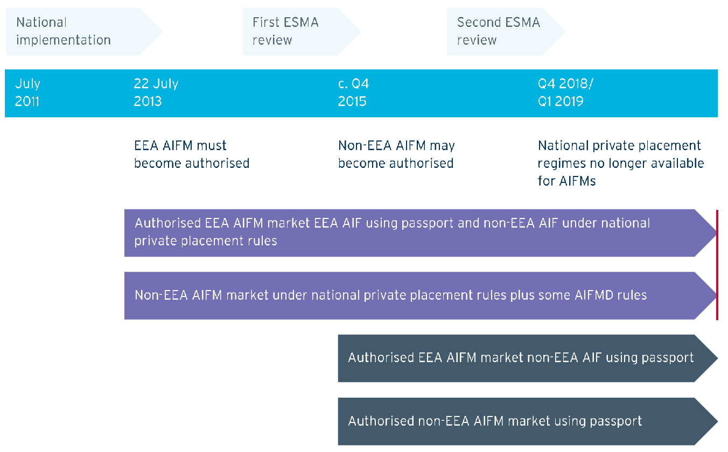
Time line
?
Source: EVCA AIFMD 3rd Country paper, 2 December 2013

Slide 26
Some key definitions and requirements
What is marketing in AIFMD
Any direct or indirect offering or placement at the initiatives of the AIFM
or on behalf of the AIFM
For investment into an AIF it manages
to or with investors domiciled or with registered offices in the EU
To the extent that an investor approaches the manager this is not "marketing“ (reverse solicitation)
Its complicated:
UK and Germany have expressed that in their view marketing happens late in the fund raising process - when and investor has all the info they need to make a decision about whether or not to invest (excludes pre closing discussion or broader promotional activities including provision of draft or generic documents).

Slide 27
Some key definitions and requirements contd…
Minimum thresholds
AIF portfolio of less than € 100 million (with use of fund level leverage)
Total AUM of AIF’s of less than € 500 million (no leverage and no redemption rights)
Its not a free passport
You still need to register with the local EU regulators
You still need to report to the local EU regulators
Grandfathering
Is allowed, unclear on non-EU AIF/M
If you have a fund with an EU investor that made new or follow-on investments post 22 July 2013, you may be in the net in some EU states

Slide 28
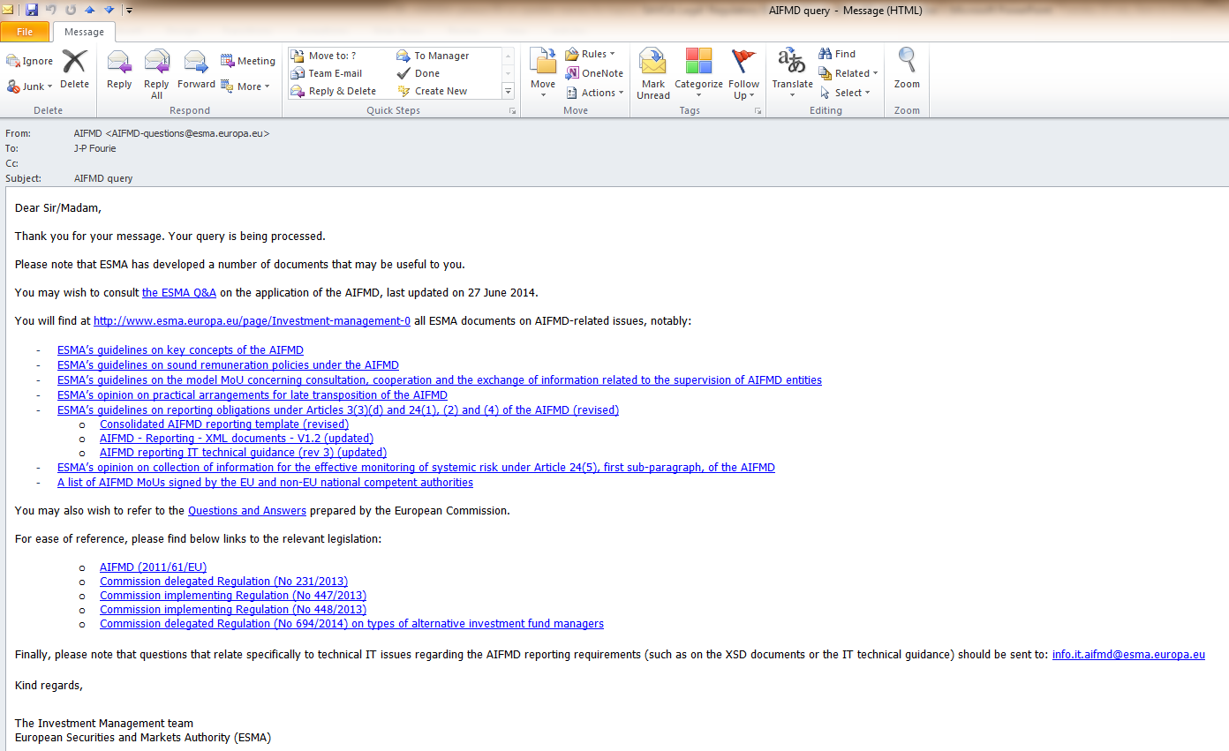
A lot for all to digest

Slide 29
Some key definitions and requirements contd…
Key requirements
FSB added in most to the proposed Cat VI FAIS Code of Conduct
Risk of non-compliance though as it does not mirror all AIFMD requirements
FSB signed MOU with ESMA to agree to co-operate and allow SA GP’s to obtain a passport in time
Transparency provisions (for marketing process and on an ongoing basis)
the investment policy and strategy of the fund
the valuation procedure and pricing methodology
management of liquidity risks
applicable fees and charges
any preferential treatment offered to investors (e.g. by side letter)
the provision of audited annual reports to the member state regulator and to investors
regular reporting to home regulators of matters such as assets, trading activity, risk profile, results of stress testing in respect of investment and liquidity risk and arrangements for managing liquidity

Slide 30
Some key definitions and requirements contd…
Specific requirements, a few examples
Remuneration split into fixed and variable, paid to staff and where relevant the carried interest paid
Aggregate amount of remuneration broken down into senior management and other staff whose actions have a material impact on the risk profile of the AIFM
Principle risks and investment or economic uncertainties that the fund may face
KPI for the fund
Custodian requirements
Use of leverage and reporting thereon

Slide 31
Some pointers
Generally, secondary market activity in fund interests do not involve marketing
In general, the remuneration and carry disclosures seem to be the sticking points
Specific requirements for portfolio company disclosure only applicable to investment into EU businesses
Keep abreast of FAIS Cat VI as this will set the benchmark in SA that hopefully the FSB/National Treasury can use to convince ESMA for the passport in 2015
If “marketing” get a view from the EU state regulators on registration, see http://www.esma.europa.eu/bos

Slide 32
BEE

Slide 33
Scorecard Overview
ELEMENT | WEIGHTING
 | DTI © | FSC | DTI(N)
Ownership | 20+3 | 14+3 | 25
Management | 10+1 | 8+1 | 15
Employment Equity | 15+3 | 15+3
Skills Development | 15 | 10 | 20
Preferential Procurement | 20 | 16 | 40
Enterprise Development | 15 | 5/15
Access to Financial Services | 0 | 12/0 | 0
Empowerment Financing | 0 | 15/0 | 0
Consumer Education | 0 | 2 | 0
Socio-Economic Development | 5 | 3 | 5
TOTAL | 100+7 | 100+7 | 105

Slide 34
Contributor level | *Points Scored (FSC) | Revised generic | Recognition level
Level 1 Contributor | >100 | >100 | 135%
Level 2 Contributor | 85 – 100 | 95 – 100 | 125%
Level 3 Contributor | 75 – 85 | 90 – 95 | 110%
Level 4 Contributor | 65 – 75 | 80 – 90 | 100%
Level 5 Contributor | 55 – 65 | 75 – 80 | 80%
Level 6 Contributor | 45 – 55 | 70 – 75 | 60%
Level 7 Contributor | 40 – 45 | 55 – 70 | 50%
Level 8 Contributor | 30 – 40 | 40 – 55 | 10%
Non-Contributor | <30 | <40 | 0%
Percentage rather than points in FS Codes context*
Multiply by 1.2 for VAS and 1.25 for ED beneficiaries

Slide 35
Other DTI changes
EME & Start-ups
Turnover<R10m
Exempt
Automatic Level 4 status
QSE
R10m<Turnover<R50m
Must report on all elements
Scorecard not defined in draft revised codes
Generic
Turnover>R50m
Comprehensive 5 element scorecard
If >50% black ownership then Level 2 status
If 100% black owned then Level 1 status
Penalised by one contributor level if thresholds for Ownership and one of Skills Development or Enterprise and Supplier Development not achieved.
Penalised by two contributor levels if thresholds for Ownership, Skills Development and Enterprise and Supplier Development not achieved.
Priority Elements – If threshold on these elements not met as per the above, then contributor level down graded
Ownership, Skills Development, Enterprise and Supplier Development

Slide 36
Thank you
www.savca.co.za
info@savca.co.za

