Slide 1


THE PSG STORY
Investing for growth
Investing for good
Jannie Mouton
13 February 2015

Slide 2

My early days
The PSG story
Carnarvon – born and school
Stellenbosch – study and friendships
Articles – PwC
Federale Volksbeleggings
SMK –1982 - 1995
2

Slide 3

SMK – 13 wonderful years
The PSG story
From ranking 42 to 5
DCM – 1985 to 1988 - >40 listings
Gilt market 0 to nr 1
Listings
  RMB,
  Richemont,
  Medi-Clinic,
  Naspers,
  M-Net, etc.
20 partners (myself CEO)
3

Slide 4
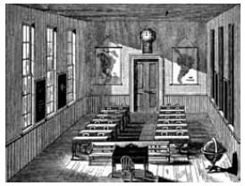
The PSG story
3 AUGUST 1995
I was fired
Lost my company and my friends
48 years old and unemployed
I lost my confidence
IN THE DAYS AFTER 3 AUGUST 1995
Kept the incident a secret
Only told my wife, Dana
Could not tell my children, mom and sisters the full story
I was confused and could not think properly
Then I realised that my future is in my hands and only in my hands
I have to lift my head
4

Slide 5
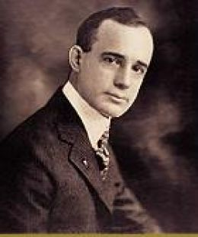
My dream
The PSG story
Listed company or big stake in it (control)
Financial services sector focus
Raise Capital for strong base
Management style – decentralised and delegated
Smart people
Move to Stellenbosch
Small head office, relaxed environment
Think more and do less
“Whatever the mind can conceive and believe it can achieve” – Napoleon Hill
5

Slide 6

The PSG story
25/11/1995 – bought control of PAG
Market cap of R7m (51% = R3.5m)
Management as partners
Raise capital
PAG personnel placements moves into stockbroking and investment services
A PLAN (DREAM) COMES TOGETHER
6

Slide 7
The PSG story – business philosophies
Read / Think / Scheme
Challenge sounding boards
Warren Buffet (summarized & typed)
My own writings and philosophies
  Charter for extraordinary achievement
  Ultimate empowerment
  Investment philosophies
7

Slide 8
The PSG story – business philosophies
Charter for extraordinary achievement
Vision (DREAM)
Goals & strategy
Team and participation
Positive and faith
Corporate governance
Assertiveness and decisiveness
Communicate!
8

Slide 9
The PSG story – business philosophies
Ultimate empowerment
“Choose competent people, place them in key positions and trust their judgement implicitly” - Conrad Hilton
Owner-managed company
Detest red tape and bureaucracy
Passion for excellence
Winners / confident
Fun and enjoy life
Purpose & Freedom
9

Slide 10
The PSG story – business philosophies
Investment philosophies
Ideal company
  Exceptional management
  High barriers to entry
  Unique product – BRAND
  Scalable
  Simple – easy to understand
  Focused
10

Slide 11
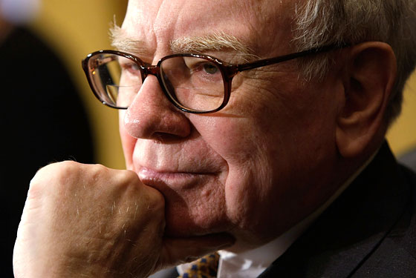
Invest for growth
“Value and Growth… the two approaches are joined at the hip: Growth is always a component in the calculation of value…”
Warren Buffet: Berkshire Chairman’s letter 1992
11

Slide 12





PSG invests for growth
PSG Group – new company established in 1995
Capitec Bank – revolutionising banking
Curro Holdings – affordable private education
Thembeka Capital – BEE as ultimate opportunity
Zeder Investments – Agri in Africa
PSG Konsult – ultimate empowerment
12

Slide 13
PSG invests for growth
  Value created since establishment
PSG’s share price at establishment (November 1995): 35c
Initial investment in Capitec unbundled in 2003
R100k investment (i.e. ~300k PSG shares at 35cps) at establishment worth ~R287m today*, consisting of:
  ~1.34m PSG shares at R132.56 per share
  ~286k Capitec shares at R383.00 per share
Total return index (TRI) = 51.2% CAGR over ~19 years
* Assuming all dividends re-invested and based on closing share prices at 30 January 2015
13

Slide 14

14

Slide 15
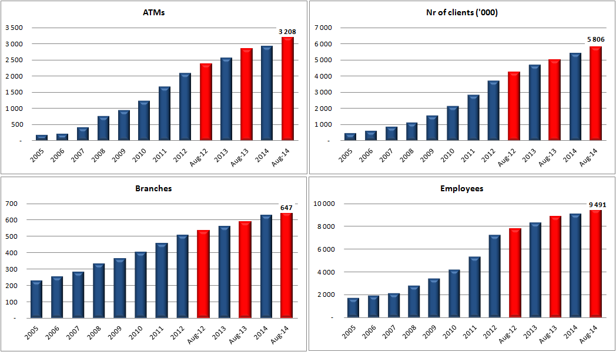
Revolutionising Banking
15

Slide 16
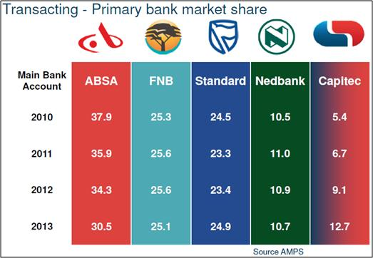
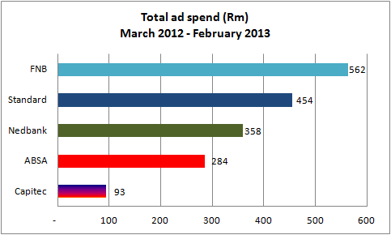
Transaction banking market share
Source: Fin24: May 2013 “Capitec ousts Nedbank from no. 4 slot”
16

Slide 17
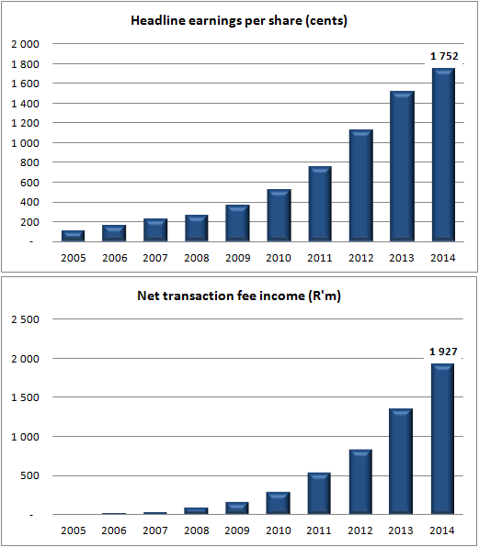
Focus to manage growth
40% CAGR for 2003 - 2014
BIGGEST LESSON
=
FOCUS
99% CAGR for 2005 - 2014
17

Slide 18

18

Slide 19





Key investments
Diversified food company with products in essential foods (wheaten flour, maize meal, rice, bread, past); groceries (cereals, biscuits, dried fruit products); Beverages
Global fruit distributor, Fruit farming, Logistics
25% interest in Golden Wing Mau (largest fruit wholesaler to formal retail in China)
Retail with agriculture focus (148 operating points)
Other agri related services
Own seed genetics
Seed production and expansive sale footprint (SA, Africa and many other parts of the word)
ZAAD
Large scale Zambian farming operation and milling
4,200 hectares under irrigation
Chicken, Eggs (market leader) and animal fees
19

Slide 20
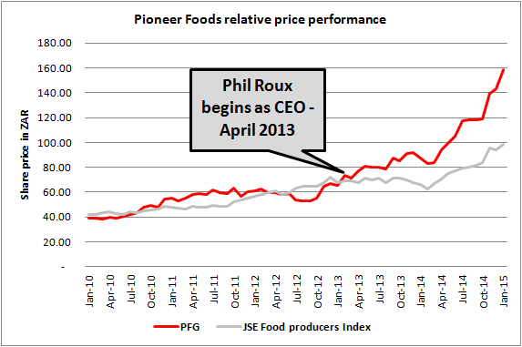
Growth investments
Pioneer Foods share price growth relative to the JSE Food Producers’ Index
20

Slide 21
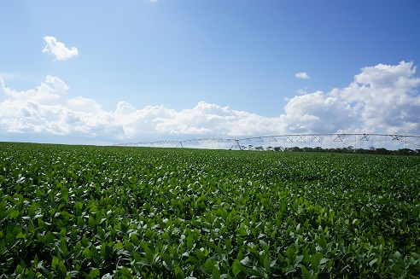
Growth investments
Irrigated hectares
Commercial farming in Zambia
Experienced Ex-Zimbabwe farmers
17-20 ton per ha possible – ‘double cropping’
Africa/Zambia many opportunities
  Poultry consumption 2.5kg per capita in Zambia vs. 31.8kg in SA
  40% of fresh water in Southern Africa
  8 bordering countries – all net importers of food
  Great opportunities in agriculture
21

Slide 22

22

Slide 23

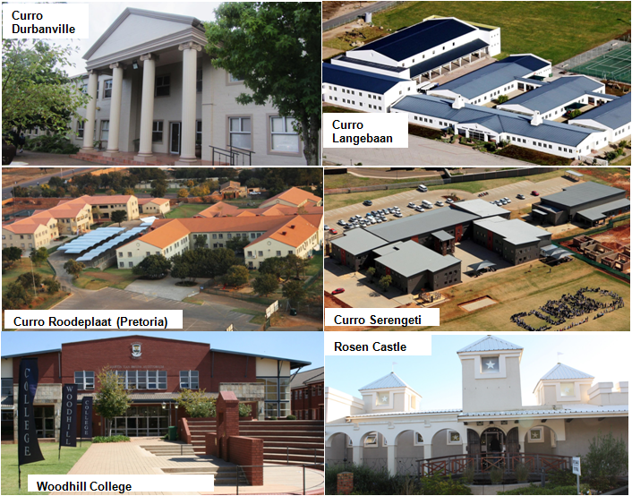
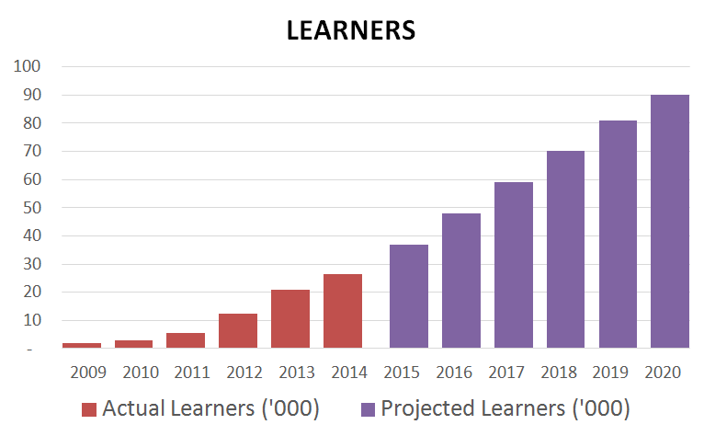
PSG - CURRO
Growth investments
Education in SA
  4% of children in private schools in SA vs 13% globally
  Limited public school capacity
  Few new schools built
  Huge opportunity for growth
23

Slide 24

24

Slide 25
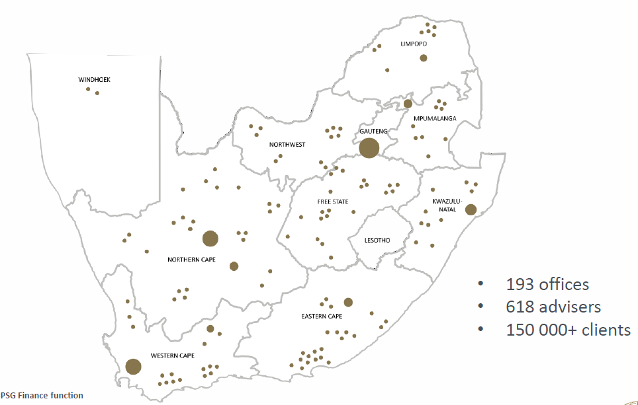
PSG Konsult
Top Wealth Manager for Successful Entrepreneurs –Business Day Investors Monthly survey for 2014
Asset management fund performance consistently in top quartile
Santam’s Top Personal Lines Broker of the year - 2013 (3rd year running)
The largest distribution network in South Africa
Top quartile performance in asset management
25

Slide 26

26

Slide 27
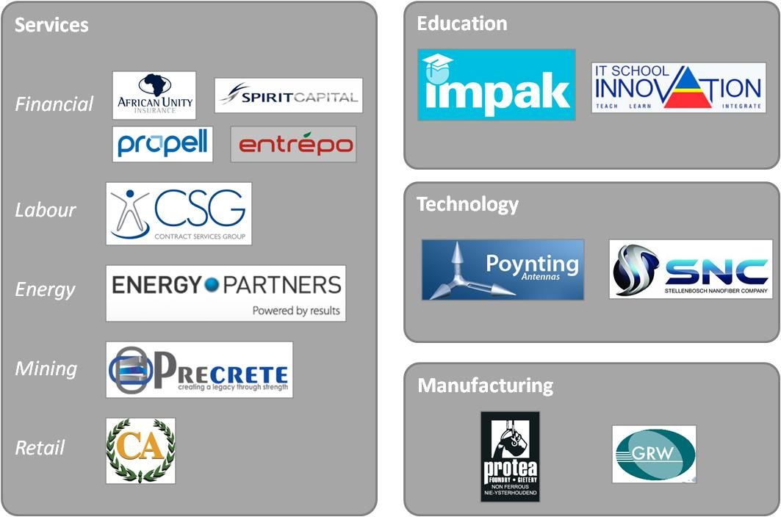
Our “Venture capital”
27

Slide 28

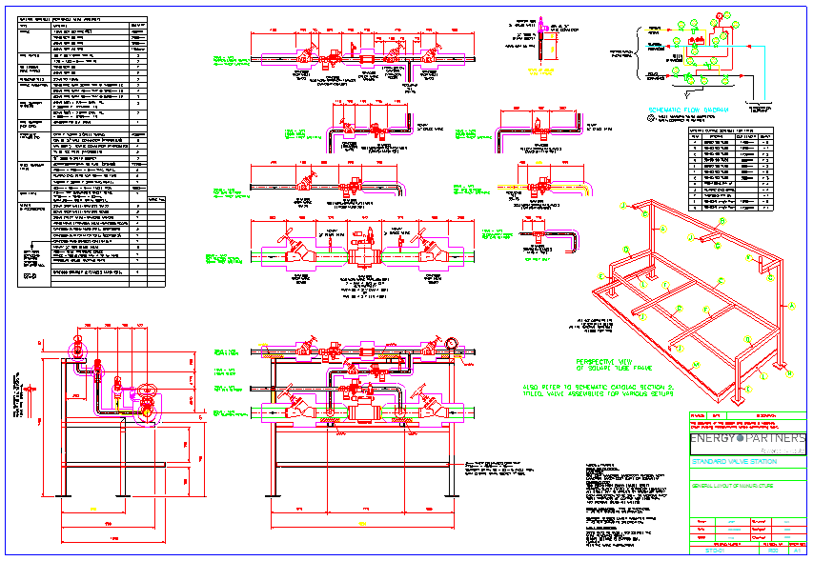

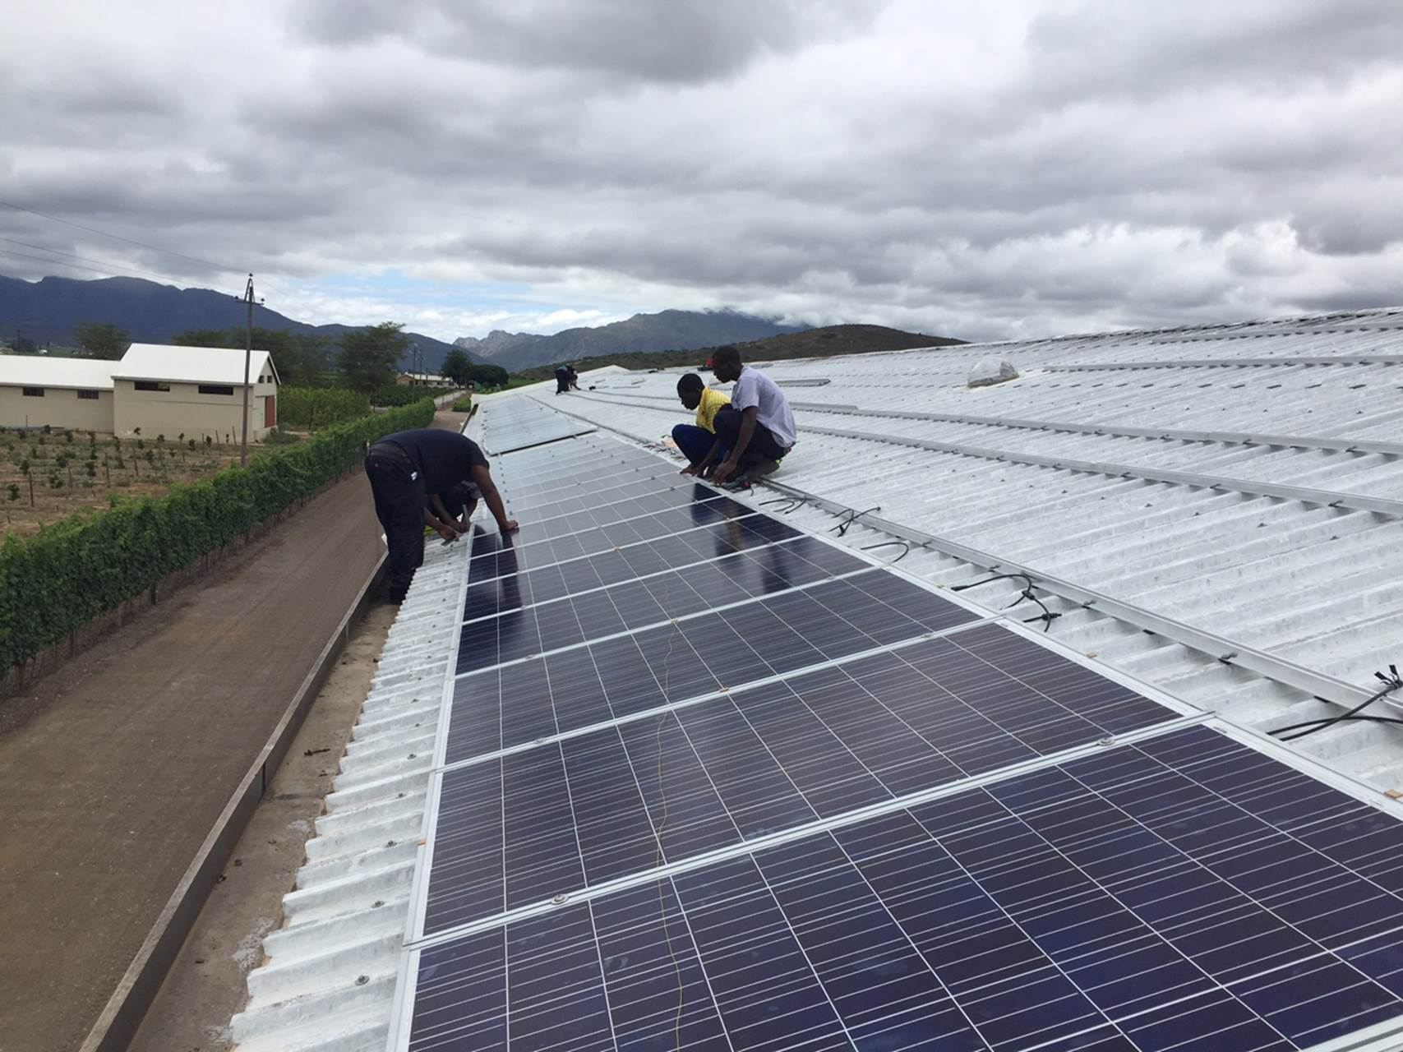
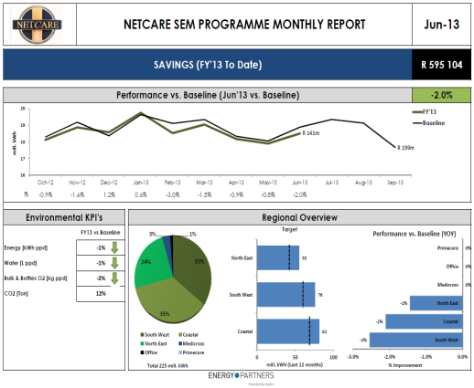
Our “Venture capital”
Design energy solutions
EP invests in Assets
Build energy systems
Monitor systems
Currently, a premier energy consulting business (steam, electricity, cool air)
Strategy: Change model to owning the energy assets and capturing some of the saving – IRRs of +25% (PSG to invest substantial capital)
28

Slide 29

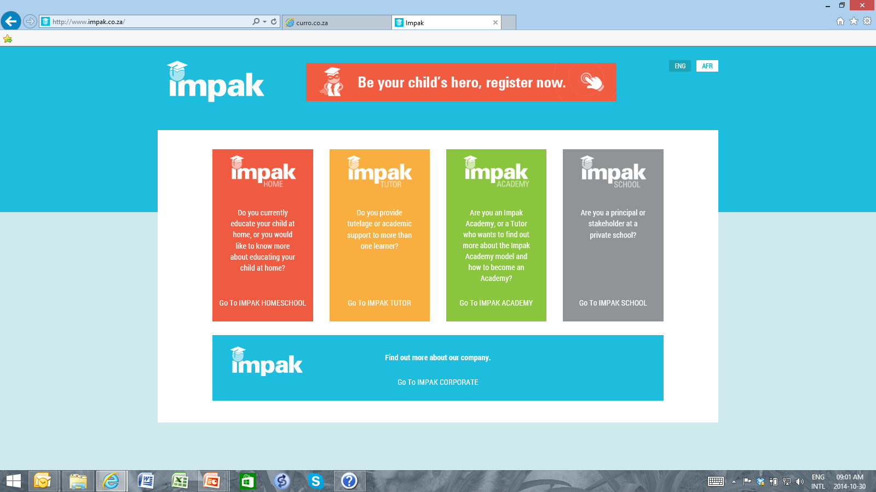
Our “Venture capital”
Market leader in home and support centre education
Target of ~90 000 learners by 2021
Afrikaans and English, Gr 0 – Gr 12
Accredited Matric
111 support centres nationally
29

Slide 30


Our “Venture capital”
“Best” provider of e-learning solutions (in our opinion) with novel features:
  Content protection in offline environment
  Negates connectivity issues typical to SA and Africa
  Allows teachers to “push” content to e-books
Strategic acquisition, serves Curro and Impak currently amongst other clients
Business growth outlook
  2013: 12 schools
  2014: 50 schools
  2019: 500 schools and R35m PAT
  International ambitions
30

Slide 31

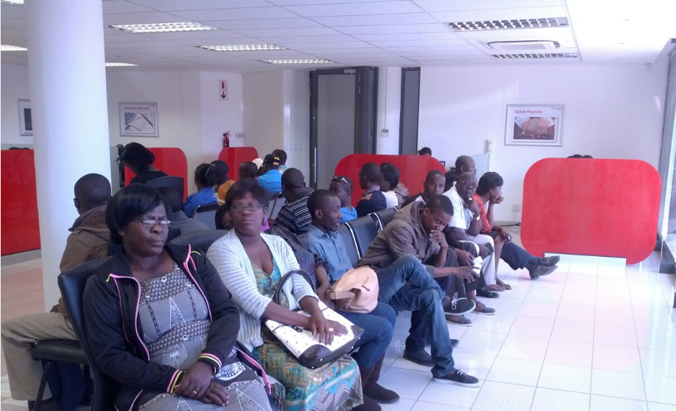

Our “Venture capital”
Unsecured lending in Namibia
Exclusively government employees
Unique salary deduction code
  one of only 5 codes
Responsible lending through Namibian Financial Institutions Supervisory Authority (NAMFISA) regulation
  Max deductions of 66% of employee salaries
31

Slide 32

Growth investments
Defence
Digital TV
Specialised antenna products for the defence market
Global business – 75% sales outside of SA
Design broadcasting systems, with equipment sales and implementation for TV broadcasters
Digital migration a growth opportunity
50% SA: 50% Rest of Africa
32

Slide 33
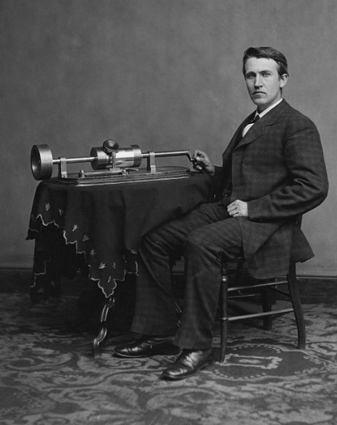
Lessons for Venture capital
Innovation and hard work are the name of the game
Thomas Edison:
“None of my inventions came by accident. I see a worthwhile need to be met and I make trial after trial until it comes. What it boils down to is 1% inspiration and 99% perspiration”
“Many of life's failures are people who did not realize how close they were to success when they gave up”
“Opportunity is missed by most people because it is dressed in overalls and looks like work”
33

Slide 34
Investing for good
HAVING A POSITIVE IMPACT ON YOUR ENVIRONMENT
“You cannot sleep in peace if your neighbour is hungry”- Anton Rupert
The PSG group as a whole
  employs people: ~R7bn in salaries
  pays taxes: ~R3bn in taxes
  makes donations: ~R20m in donations
  training and bursaries: ~R40m in bursaries
34

Slide 35
Invest for Good
Investing for good
Please join us for lunch
PSG Group BEE Employee Trust
Established in 2006
More than 500 beneficiaries employed within the PSG Group (incl. PSG Konsult, Curro and PSG Corporate Services)
More than R300m investment value in PSG Group shares
More than R4.5m distributed to beneficiaries since 2008
Stellenbosch BEE Education Trust
Established in 2011
R102m funding given by PSG Group for investment
More than R500m investment value in Thembeka shares
Beneficiaries are deserving learners from previously disadvantaged backgrounds
35

Slide 36
Invest for Good
Investing for good
Please join us for lunch
PSG Group Bursary Loan Scheme at the University of Stellenbosch
Established in 2007
Donated: 100 000 PSG Group shares; a further R100 000 cash per year
  More than R1.5m received by the scheme in dividends
  ~R10m current investment value of PSG Group shares held
More than 50 students have been beneficiaries
Various fields of study incl. medicine, actuarial science, accounting and investment management
36

Slide 37

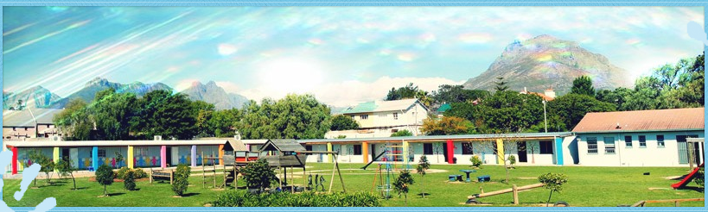
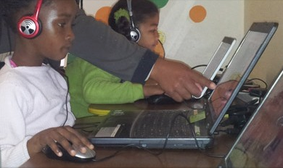

Invest for Good
Investing for good
Please join us for lunch
Akkerdoppies
Early childhood development
High-quality affordable pre-school services to children from Idas Valley, Cloetesville and Khayamandi
Beneficiaries: 162 children aged under 7 years
37

Slide 38
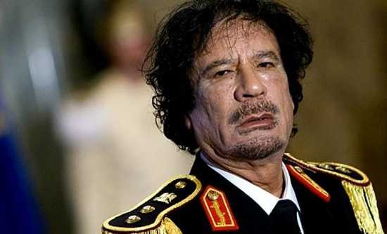
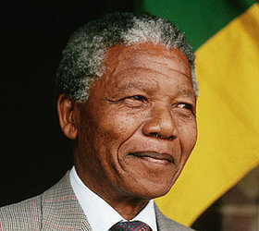
PSG – INVESTMENT PRINCIPLES
Investing for good
Great corporate governance not negotiable
  Integrity
  Transparency
  Good, timely information
  Trust
Low barriers to entry
High barriers to entry
38

Slide 39
Thank You
Questions?

